Slide 1
Flappy Bird
The Coding Cobbers
Matthew, Huy, Kai, Ben

Slide 2
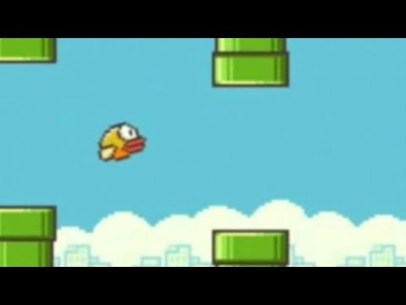
OG Flappy Bird

Slide 3
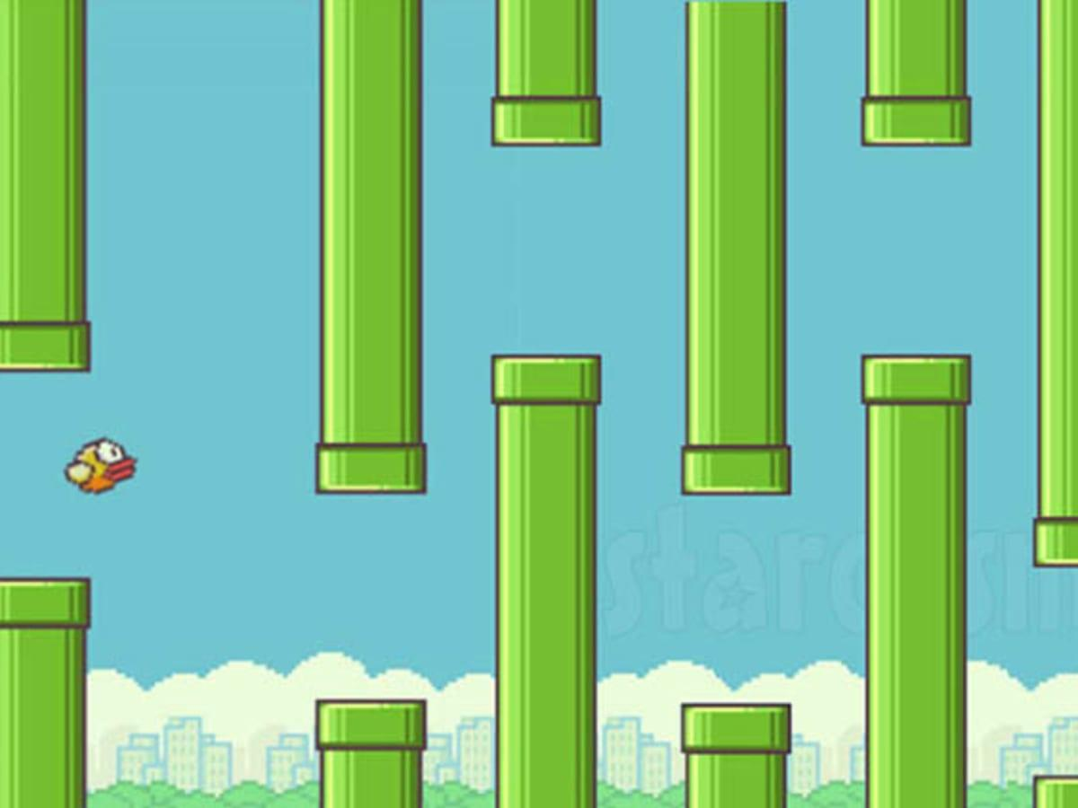
Objectives of the Game
-Get as far as you can
-Don’t hit the pipes
-Try to have fun (very frustrating)
-Game gets harder as you go

Slide 4
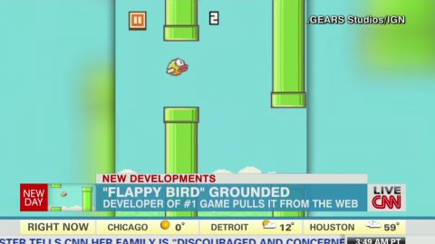
Making the changes from the original
-Being careful with graphics
-Copyright
-Maybe exploring different themes (different birds, underwater theme, ect.)

Slide 5
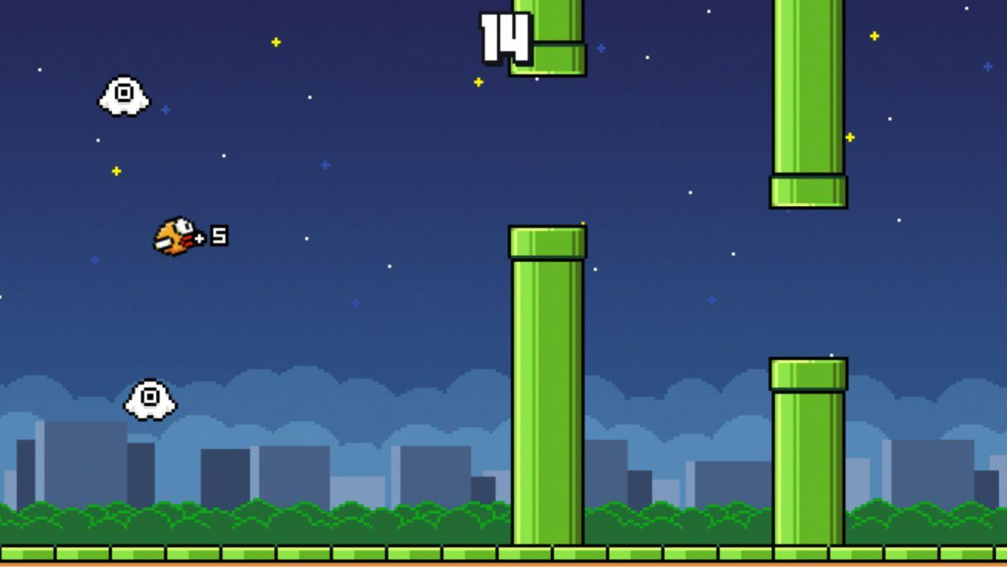
Our Stages
-Resources
-Planning
-Coding
-Debugging
-Presenting

Slide 6
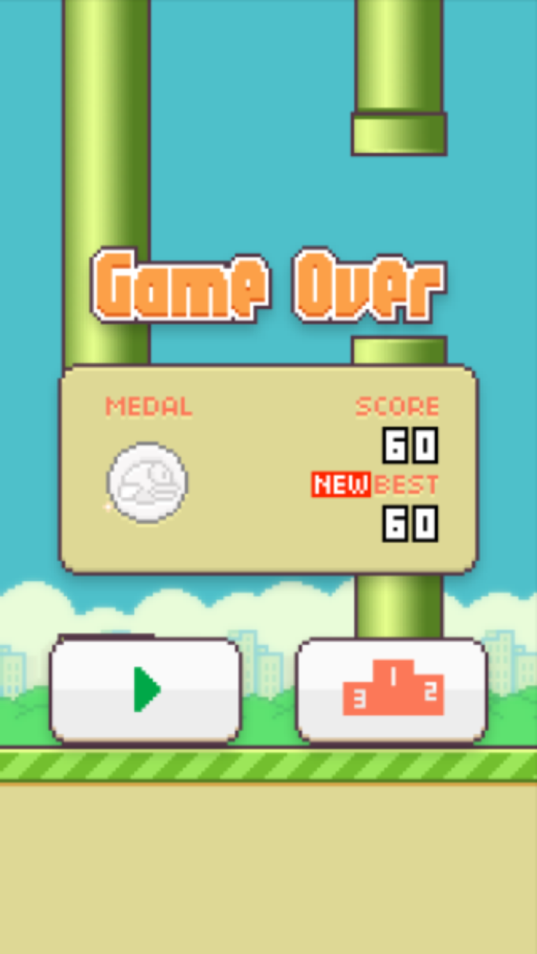
Classes In the Code
-Pipes, both top and bottom
-Bird, colors
-Movement
-Map, background

Slide 7
Sources Cited
IGNentertainment. “Flappy Bird Gameplay.” YouTube, YouTube, 31 Jan. 2014, aaaahttps://www.youtube.com/watch?v=fQoJZuBwrkU&ab_channel=IGN
Hobers, Matthew. “Java Flappy Bird Source Code · 32D13A8774E44A5A1EF4A008F74604B7B99C4FA8 · aaaaJam / Flappy.” GitLab, 2016, aaaahttps://gitlab.cas.mcmaster.ca/JAM/Flappy/-/tree/32d13a8774e44a5a1ef4a008f74604b7b99c4fa8/Java%2aaaa0Flappy%20Bird%20Source%20Code.

